Slide 1
UX Research for Taproot Digital Outreach Initiatives
By: Matthew H, Kyle B, Chris E, Victoria T, and Hannia G.

Slide 2
Our Roles:
Matthew Hernandez, Project Manager, Researcher Christopher Emerson, Researcher, Data Interpreter
Victoria Travier, Researcher, Implementer
Hannia Gonzalez, Implementer, Designer
Kyle Bretzius, Researcher, Data Interpreter
Notes:
Matthew will introduce us and go down the list.

Slide 3
Overview
Client Overview
Our client
Services Offered
Purpose of Research
Research Objectives
Our Methodologies
Key Findings
Storyboard Design
6. Recommendations
7. Conclusion
8. Q&A
9. Thank you
Michigan State University
Notes:
Matthew will talk about the overview.

Slide 4
Our Client
Taproot Law, based in Marquette, Michigan, is a human-centered law firm committed to providing accessible and affordable legal services, with a particular focus on marginalized demographics such as elderly populations and individuals with limited internet access.
Operating in the Upper Peninsula of Michigan, Taproot recognizes the unique challenges faced by these communities and aims to bridge the gap in legal assistance by prioritizing accessibility and affordability for all.
Michigan State University
Notes:
Kyle will introduce the client.

Slide 5

Taproot’s Services
Taproot offers a range of legal services tailored to meet the needs of diverse clientele in the Upper Peninsula of Michigan, including coaching workshops, consultation, and legal advice.
Notes:
Kyle will introduce the services.

Slide 6
Purpose of UX Research
Our study aims to enhance Taproot’s services by deeply understanding needs, behaviors, preferences, and expectations of various groups and improving digital outreach.
We focus on refining communication strategies and tailoring accessibility features to ensure a seamless and personalized legal experience for each client, especially through innovative digital mediums.
Michigan State University
Notes:
Matt will introduce purpose of UX research.

Slide 7
A meeting with the Founder of Taproot
After a previous meeting with Erika we learned how she uses legal coaching and tools like Google Form worksheets to simplify legal processes. Also that she's developing a library network to help those with limited internet or whoever has a preference for paper documents. Erika, who specializes in probate and real estate, blends low-tech and high-tech solutions to fulfill the various demands of her clients, especially the elderly who prefer less complicated technology.
Michigan State University
Notes:
Matt will introduce purpose of UX research.

Slide 8

Our Research Objectives
Specific Goals of Research, Key Questions
Michigan State University
Notes:
Victoria will talk about research objectives.

Slide 9
Goals for Research
Validate innovative solutions for accessible legal services targeting elderly and internet-limited users.
Understand demographic trends and legal preferences to tailor services effectively.
Enhance usability of communication materials and benchmark strategies for clarity and accessibility.
Michigan State University
Notes:
Victoria

Slide 10
Key Questions
Is it effective to boost Library Networks through fliers posted on flyer boards?
2. What are ways that we could spread reliable legal advice out to the public?
3. Are clients comfortable with adding confidential information onto online forms?
Michigan State University
Notes:
Chris

Slide 11
Storyboard Design
Start Here!
Taproot Legal Tech
Phase I : Questionnaire about Legal Tech Services
Research Proposal
The end
Phase II : User Feedback on Flyer
Flyer
Michigan State University
Notes:
Victoria

Slide 12
Mixed - Methods Approach
Phase 1: Quantitative Research
Conducted among Michigan State students, to collect quantitative data on user demographics, legal service usage, and preferences.
Phase 2: Usability Testing
Engaged both faculty and students, who provided feedback through Qualtrics on their experiences with a flyer, aimed at evaluating our potential outreach effectiveness within Library Networks.
Notes:
Chris

Slide 13
Phase 1 Data
Michigan State University
Notes:
Chris

Slide 14
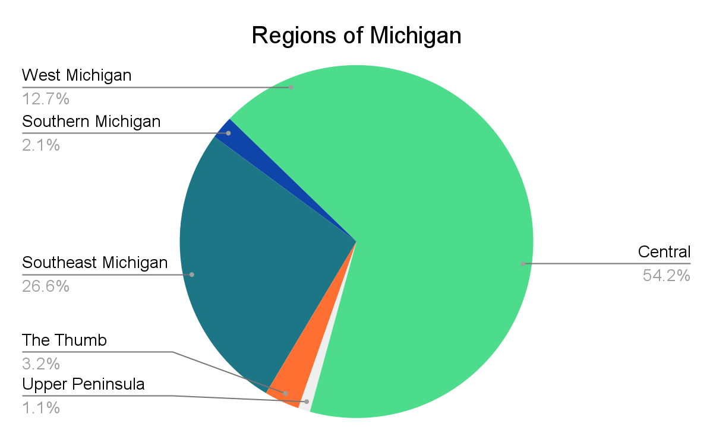
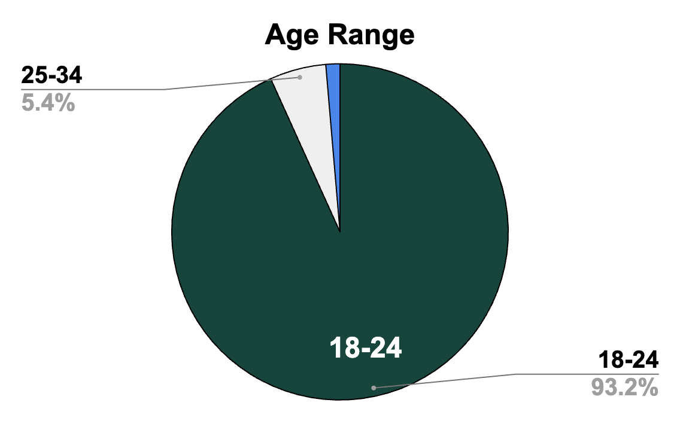
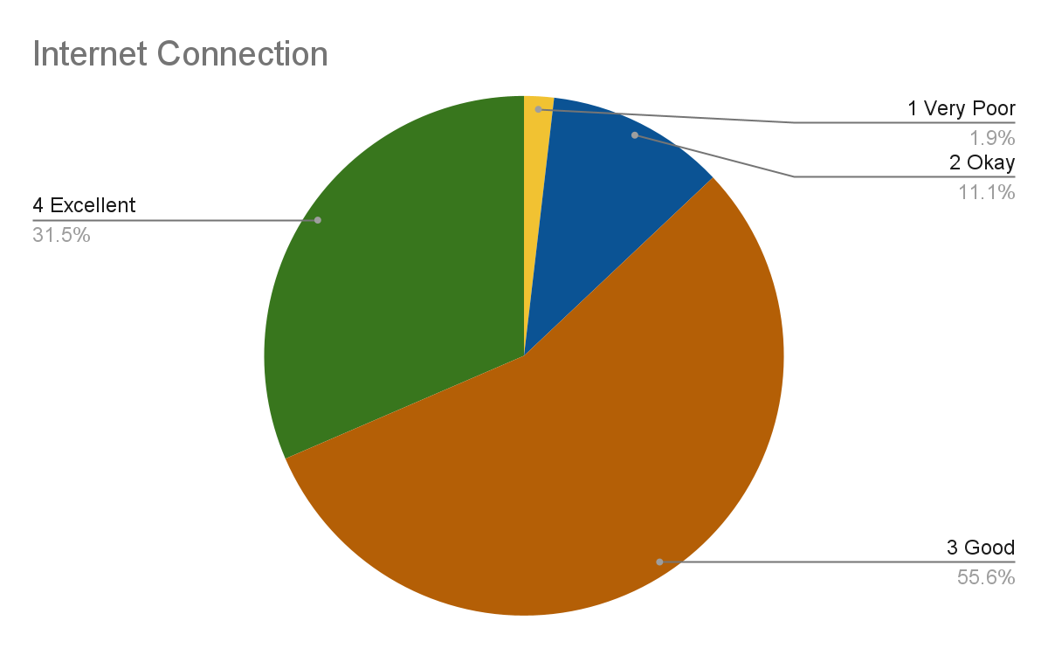
Age Range: Due to our location, we were only able to get younger participants for our questionnaire ranging from 18-35.
Regions in Michigan: Most participants thought Taproot serviced mostly people in Central region of Michigan.
Internet Reliability: The quality level of Internet connectivity participants have.

Slide 15
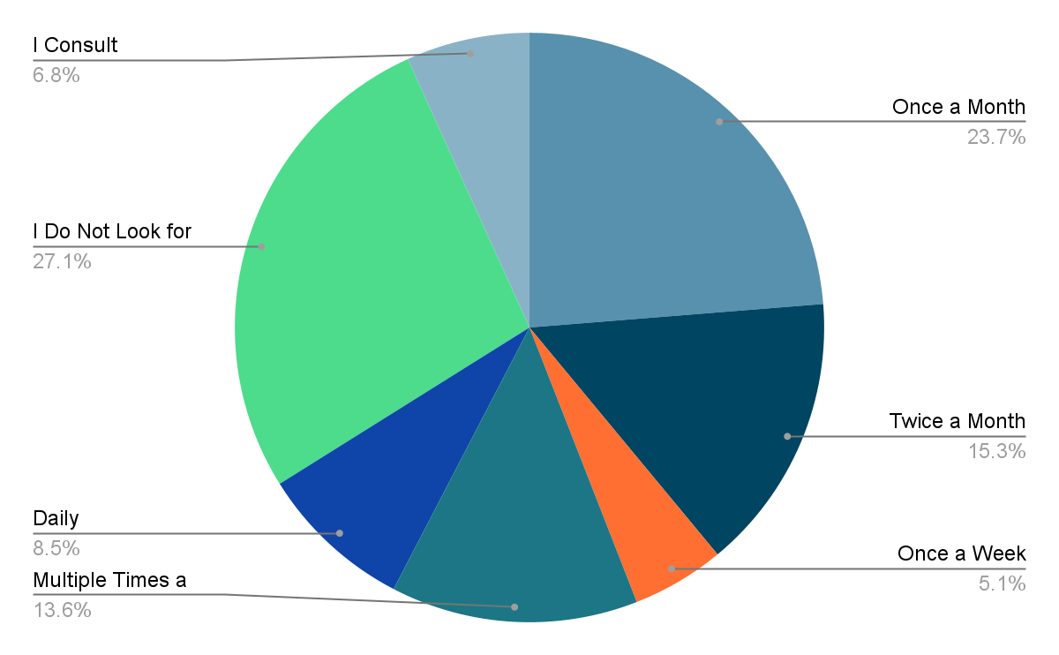
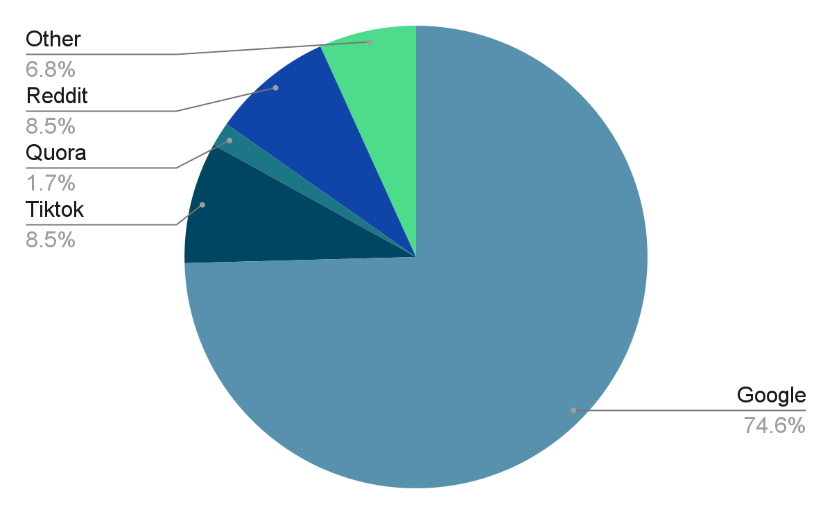
Legal Advice Seeking Data Insights
Preferred Platforms Amongst Participants
Participants Search Frequencies
Notes:
Kyle

Slide 16
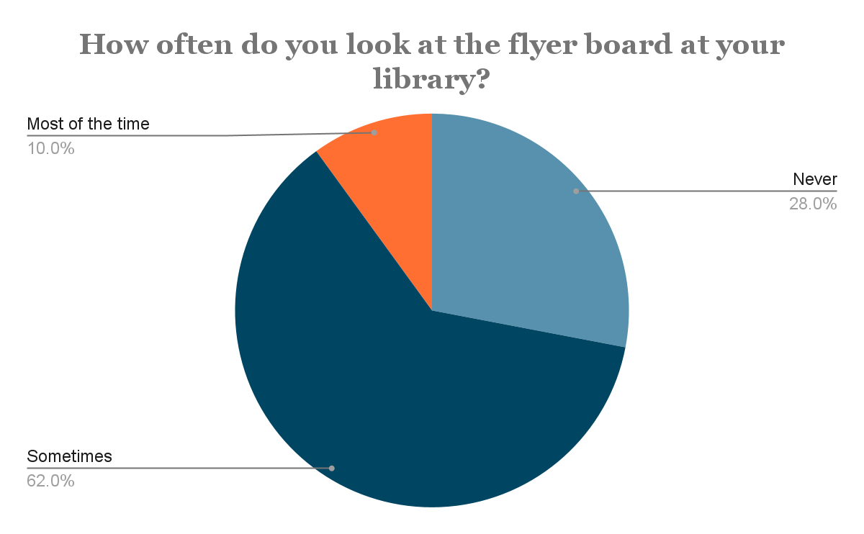
Library Network Supporting Data
Notes:
Kyle

Slide 17
Phase 1: Key Findings
93% of Phase 1 Participants are within the age range of 18-24.
74.6% of participants selected Google as a platform they use for Legal Advice, bringing up a possible concern as to the reliability of their sources.
Due to a mistake in the survey development process, we were unable to gather insights on what participants meant by “Other”.
It is important to note that due to time constraints and difficulty in gaining access to email lists that contained faculty members, we were unable to survey participants in older age groups.
In order to support our proposal of implementing a library network in the local vicinity of Taproot, we collected data on participants’ activity at their local libraries and how often they access a flyer board, pinboard, etc.
62% of participants sometimes access their flyer board with 40% of the researched population not knowing if their library has a pinboard, flyer board, etc.
Michigan State University
Notes:
Hannia

Slide 18

Original Flyer Design
Considered color scheme to align with Taproots website branding.
Placed contact information at the top to ensure it was the first thing survey respondents noticed.
Designed the QR code to complement the flyer’s design style, incorporating elements such as leaves to match Taproot perception.
Notes:
Hannia

Slide 19
What Caught User’s Attention?
Pros
The Logo; most users loved the tree design
Font size was very bold and up front
A user recognized the 906 area code
Cons
Typography; Feels out of place for something in law
Typeface color is brighter than other elements
Adjust the spacing and line breaks to make is more readable
Michigan State University
Notes:
Victoria

Slide 20

Revised Flyer Design
Contact information relocated to the bottom, along with a QR code for easier access.
Color scheme adjusted to a lighter tone for improved readability and reduced eye strain.
Basic estate planning information expanded to include what type of help like (wills, trusts, and more.)
Notes:
Hannia

Slide 21

User Feedback from Phase II
Attention Grabbing Elements
Understanding of Services
Engagement and Feedback
QR Code Effectiveness
Likelihood of Recommendation
Michigan State University
Notes:
Hannia
Typography, firm name, and logo were primary attention grabbers.
Varied understanding of services offered by Taproot Law
Interest in contacting Taproot Law for information or appointments.
Mixed success with QR usage.
Moderate likelihood of recommending Taproot Law’s services.

Slide 22
Explaining User Feedback and its impact on Library Networks.
Feedback from users is very important and can help create such programs at the library.
Library Outreach Program
Digital Marketing Campaign
Community Partnerships
Michigan State University
Notes:
Hannia

Slide 23
Overall Interpretation
Research highlighted significant engagement with the flyer, coupled with valuable feedback for improvement.
Demographic insights provided with a clear understanding of the target audience and their technological accessibility.
Recommendations for flyer enhancements aim to optimize engagement and increase the likelihood of client acquisition and satisfaction.
Michigan State University
Notes:
Hannia

Slide 24
Library Concerns
Concerns:
Visitation Frequency
Presence of Pin Boards in Libraries
Viewing of Flyer Boards at the Library
Likelihood of Downloading Apps Advertised on Flyer Boards.
Importance of Data:
This data highlights how people engage with their libraries and what they notice there. Helps us understand visitation habits, awareness, and interaction with flyer boards.
Notes:
Chris

Slide 25
Phase II: Usability Testing
Michigan State University
Notes:
Hannia

Slide 26
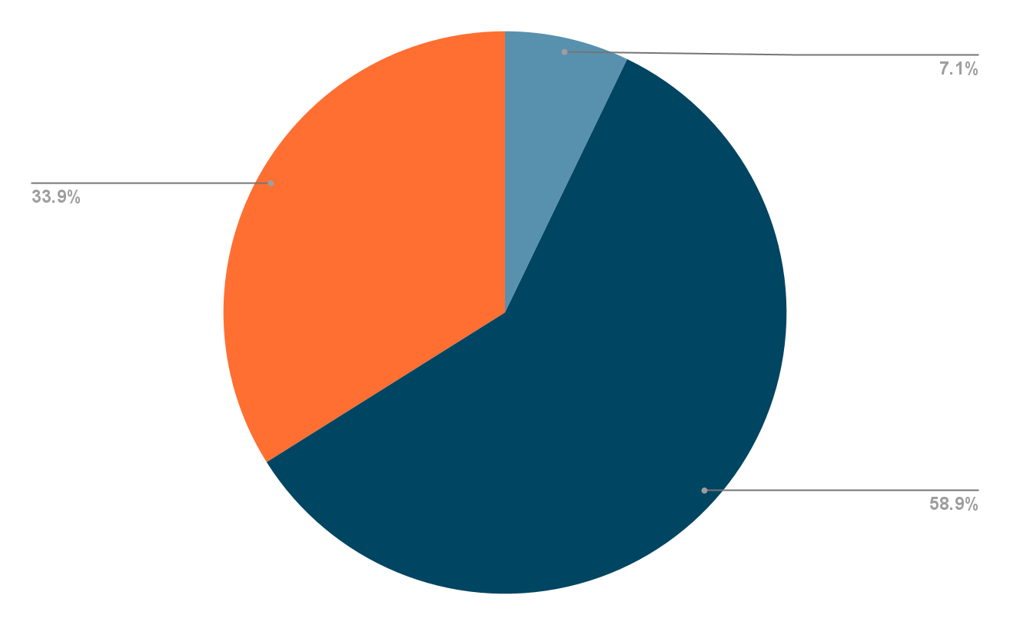
Data Security Concerns
Very Comfortable
Not Comfortable At All
Comfortability Level when inserting confidential information.
Somewhat Comfortable
Notes:
Matthew - we were able to safely assume this based on the data we gathered on the question Data Security Concerns. Safier method of receiving confidential information?

Slide 27
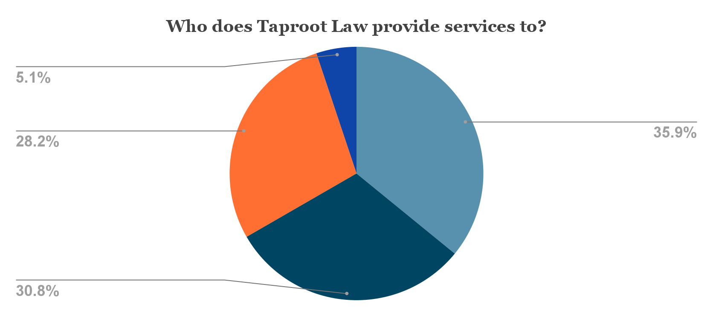
An example of confusion from the original flier:
Other: (please specify)
Everyone, regardless of their location
Not specified in the flyer.
Only to residents of Northern Michigan.
Residents of specific cities within Michigan - 0 %
Michigan State University
Notes:
Victoria

Slide 28
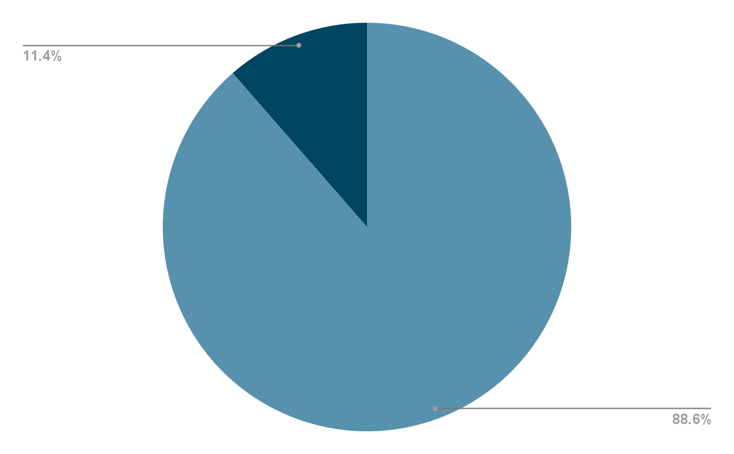
Do Users Think Taproot Offers A Diverse Range of Services?
No - I do not think Taproot offers a diverse range of services.
The diversity level of Taproots current services.
Yes - I believe Taproot offers a diverse range
of services
Michigan State University
Notes:
Kyle- with this data we were able to see that most people believe taproot offers a diverse range of services which include coaching, the make it legal services, workshops and the make it legal administration which is a positive sign that people are familiar with their services

Slide 29
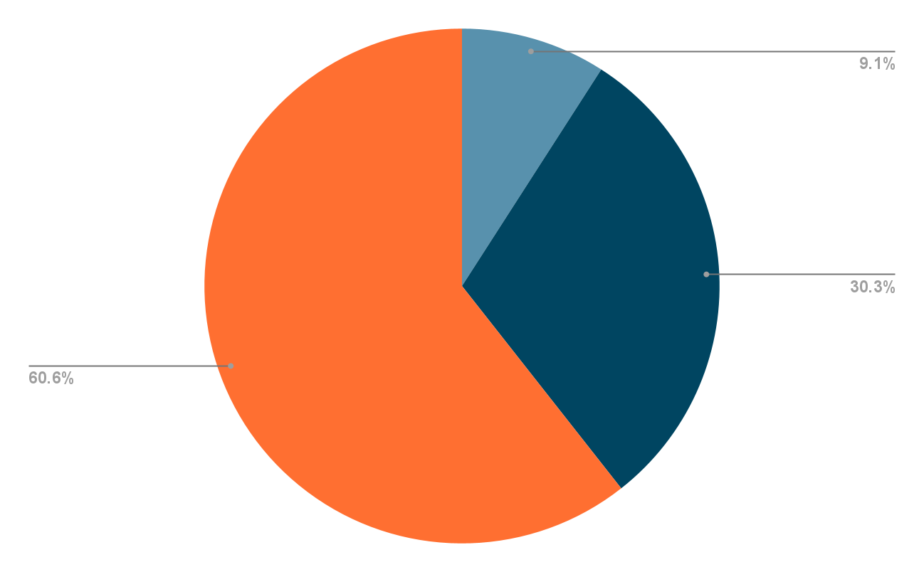
Would Users Want to Contact Taproot to Assistant with Their Concerns?
High Likely - I would definitely contact Taproot for guidance
Getting in touch with Taproot for assistance.
Unlikely - I would not consider contacting Taproot.
Somewhat likely - I might consider reaching out to Taproot.
Michigan State University
Notes:
Kyle- More data we gathered shows us that the majority of people would be somewhat likely to contact taproot for any help if they have concerns which is a good sign telling us clients are comfortable

Slide 30
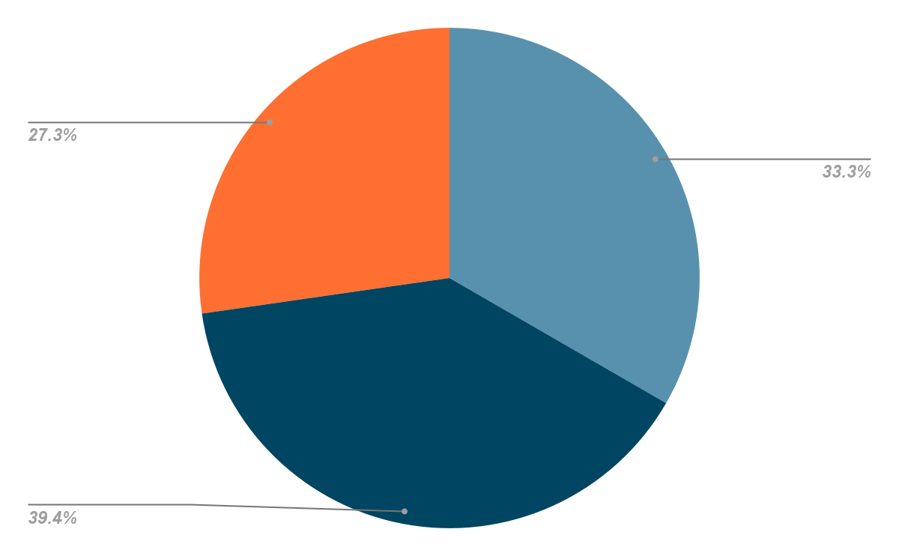
How Would Users Prefer to Get in Contact with Taproot?
Visit the Taproot website via a provided link.
Use a QR Code to access scheduling through my mobile device.
Most preferred method of booking appointments.
Call Taproot directly for personal assistance.
Michigan State University
Notes:
Victoria - Based on the data

Slide 31
Proposals
Michigan State University
Notes:
Matthew

Slide 32
We suggest that Taproot establish library networks by placing flyers in Marquette-area libraries and introducing a measurement system to track engagement through QR code scans or feedback surveys.
This approach should enable people to access dependable legal information and enhance their comfort with Taproot’s services.
Michigan State University
Notes:
Matthew

Slide 33
Thank you!
Michigan State University
Notes:
everyone

